Slide 1
Retail Giant Sales Forecasting Assignment
Presented by
Sohini chaudhuri

Slide 2
Business Objective
‘Global Mart” is an online store super giant having worldwide operations. It takes orders and delivers across the globe and deals with all the major product categories – consumer, corporate and home office in seven different market regions.
The data currently has the transaction level data, where each row represents a particular order made on a online store
The aim is to forecast the sales and the demand of the two most profitable market s and in respective segments, which will help in maintaining the revenue

Slide 3
Problem Solving Methodology
1. Reading the Dataset
- Inspect the dataframe's columns, shapes, variable types etc
3. Data Preparation
4. Feature Engineering
5. Exploratory Data Analysis
6. Plot the Time series
7. Train and Test split
8. Simple moving average method
9. Decomposition of time series
10. Smoothing techniques
- Holt's exponential smoothing
- Holt- Winter exp smoothing
11. Stationarity of time series
12. ACF and PACF plots
13. ARIMA model
14. Seasonal-ARIMA model

Slide 4
Data Understanding
51290 transactions from 2011-2014
Focusing mainly on month and year wise aggregrated values of Sales, Profit and Quantity
With 3 segments and in 7 market regions

Slide 5
Data Preparations
Prepared the aggregated data with 21 market segments
Found the top 2 most profitable segents as APAC-Consumer and EU – Consumer by calculating Coefficient of Variation

Slide 6
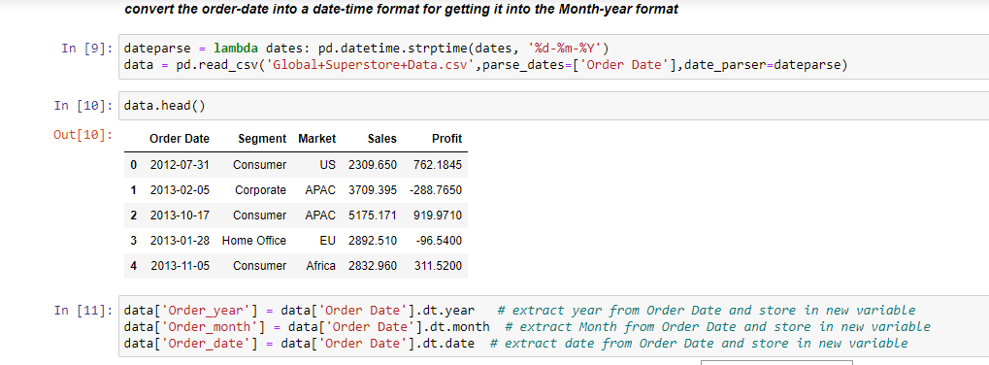
Feature Engineering
Convert the order-date into a date-time format for getting it into the Month-year format

Slide 7
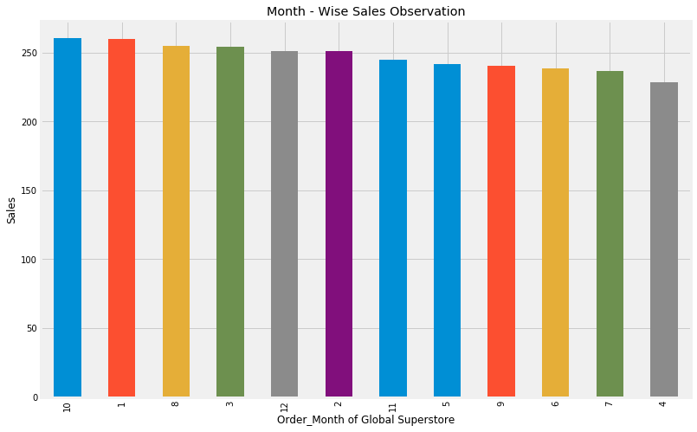
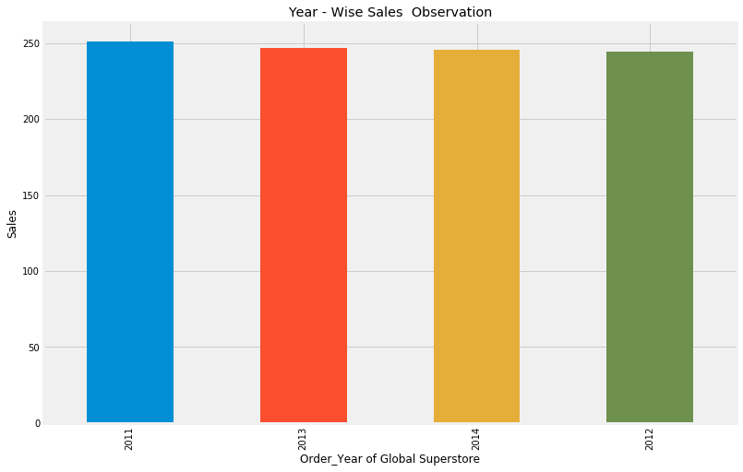
Exploratory Data Analysis
Year - Wise Actual Sales Observatio
Month - Wise Actual Sales Observation

Slide 8
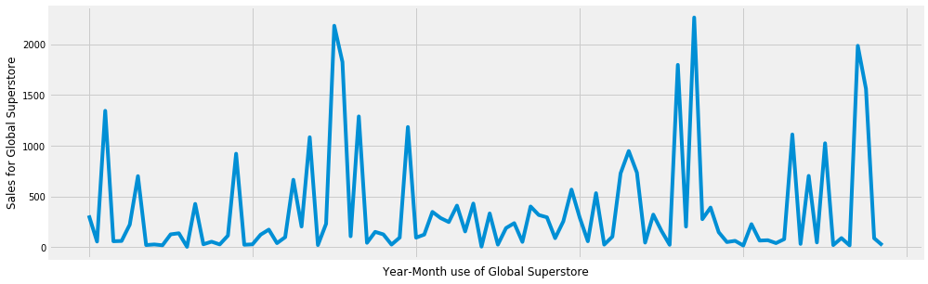
Plot the Time series

Slide 9
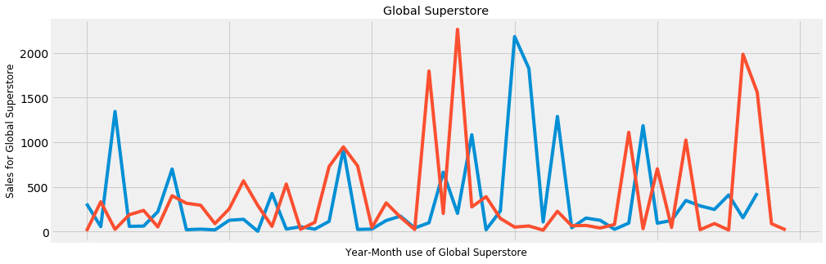
Train and Test split

Slide 10
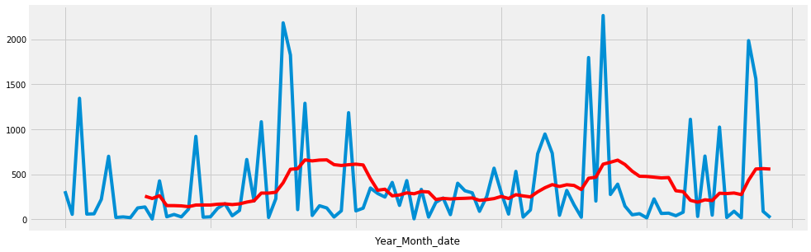
Simple moving average method

Slide 11
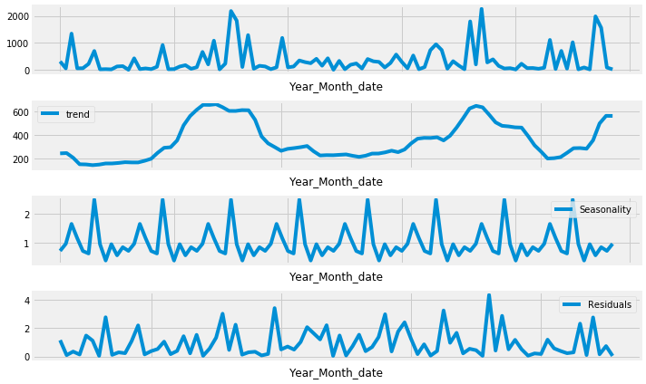
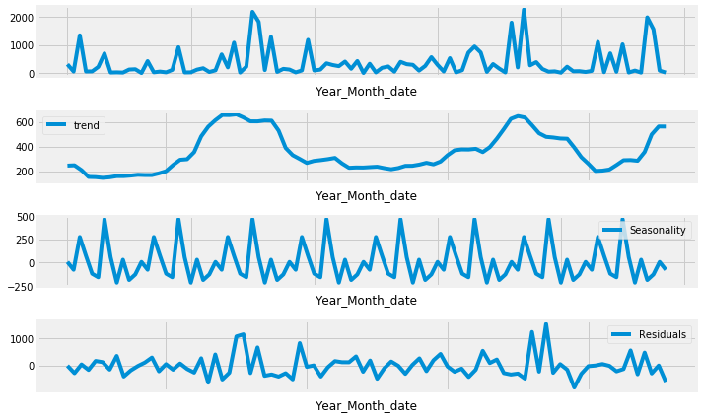
Decomposition of time series
Multiplicative series
Additive model

Slide 12
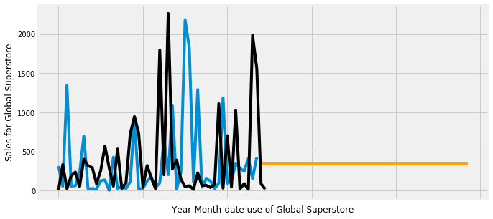
Smoothing techniques
It removes the flunctuations or noise from a time series. The flunctuations may be due to seasonal and irregular components.
By eleminating these two our series reflects only trend and cyclic pattern.
Since moving average assign equal weight to all data points where as the recent obsn provide more relevant informatiopn than past obsn. So we want a weighting system that assigns decreasing weights to the more distant obsn. For this we use exponential smoothing technique.It gives more weight to recent obs and it decreases exponentially as obs become more distant

Slide 13

Holt's exponential smoothing

Slide 14
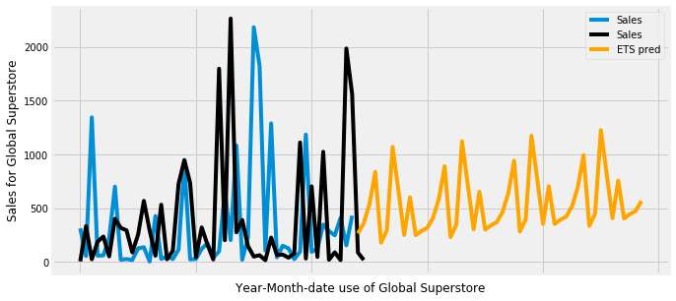
Holt- Winter exp smoothing

Slide 15
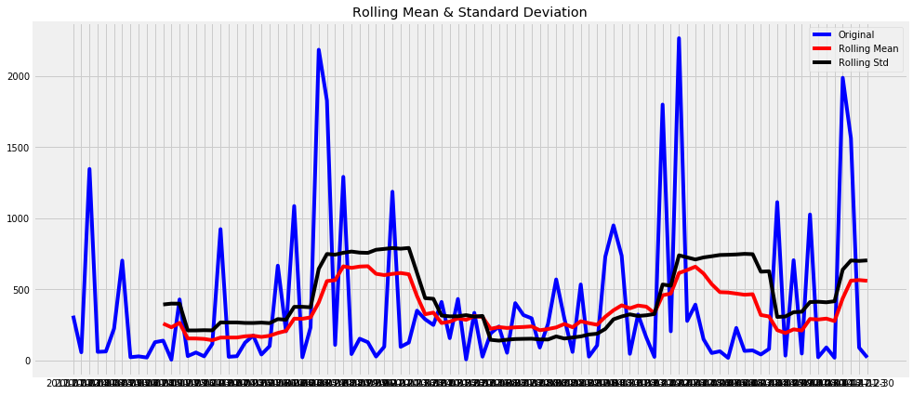
Stationarity of time series

Slide 16
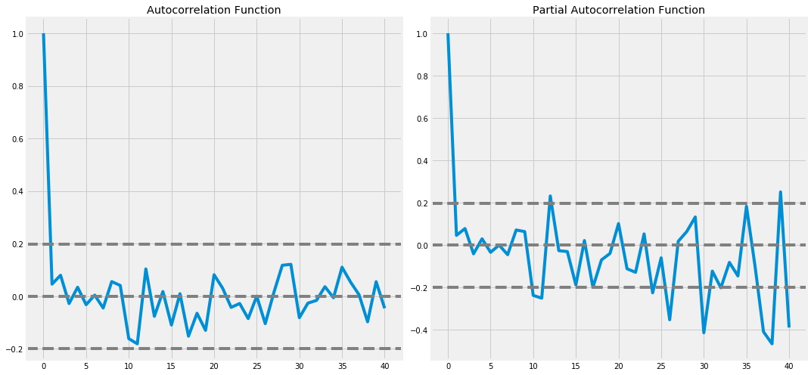
ACF and PACF plots

Slide 17
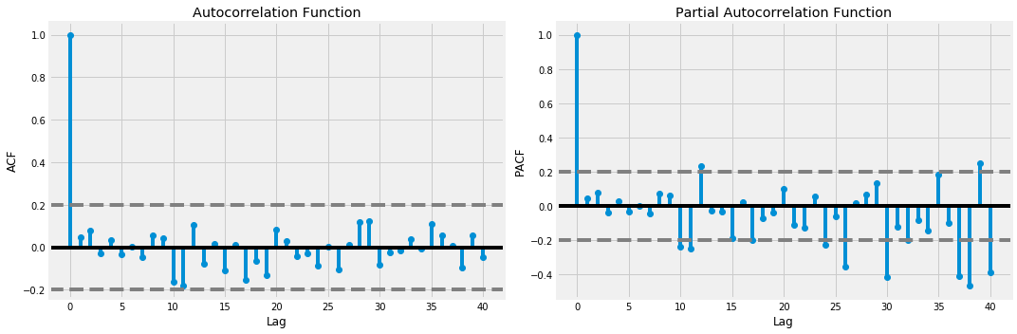
ACF and PACF plots

Slide 18
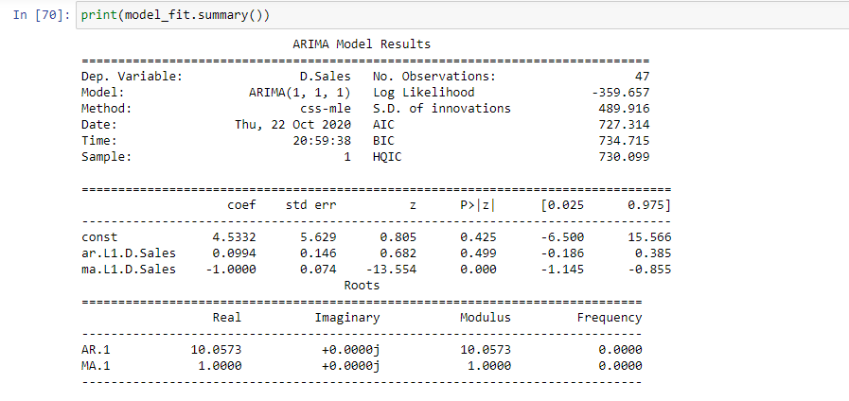
ARIMA model

Slide 19
Seasonal-ARIMA model
ARIMA doesn not support seasonality . If our data has defined seasonality then we go for S-ARIMA.
Seasonal differencing is like regular diff but instead of subtracting consecutive terms we subtract the values from previous season
parameters in SARIMA(p,d,q)(P,D,Q)[S] P - seasonal AR D - seasonal differencing Q - seasonal MA S is the frequency of time series
p is equal to the first lag where the PACF value is above the significance level.
d is the minimum order of difference to make the series stationary.
q is equal to the first lag where the ACF value is above the significance level
S is equal to the ACF lag with the highest value (typically at a high lag).
D=1 if the series has a stable seasonal pattern over time.
D=0 if the series has an unstable seasonal pattern over time.
Rule of thumb: d+D≤2
P≥1 if the ACF is positive at lag S, else P=0.
Q≥1 if the ACF is negative at lag S, else Q=0.
Rule of thumb: P+Q≤2

Slide 20
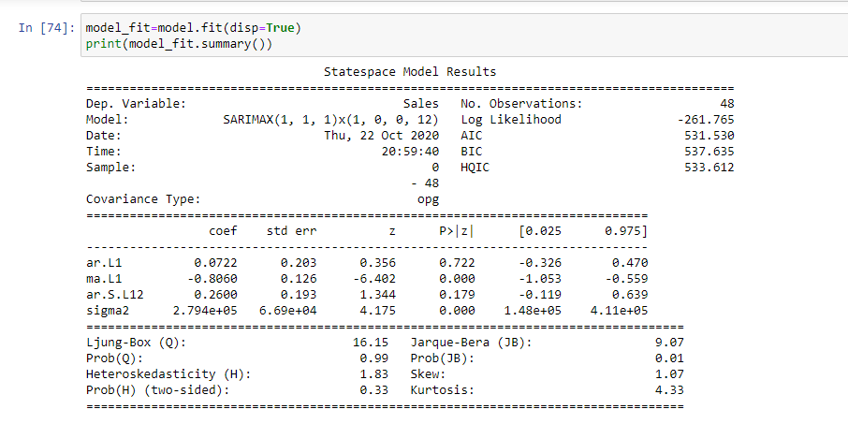
Seasonal-ARIMA model

Slide 21
Conclusions and Recommendations
Based on the data provided we helped “Global Mart” in identifying 2 most profitable market segment as APAC Consumer and EU Consumer and modelled them using classical decomposition.
These are 4 key forecasts on the test data are as follow :
a. APAC Consumer Sales is likely to rise in next 6 months with small fluctuations.
b. APAC Consumer Quality is likely to rise steeply in coming 6 months.
c. EU Consumer Sales may ahow the slow rise in coming months.
d. EU Consumer Quality is likely to drop during initial 1 or 2 months & then rise rapidly in next 3 months, eventually reaching a plateau.

